Slide 1

Introduction to Operating Systems CS/COE 1550
Fall 2021
Sherif Khattab
ksm73@pitt.edu
(Some slides are from Silberschatz, Galvin and Gagne ©2013)

Slide 2
Announcements
Upcoming deadlines:
12/20 at 5:00 pm: Project 4
Please check Canvas for the rest of the deadlines
Bonus opportunities
Bonus homework
Post-course test
OMET bonus (response rate >= 80%)

Slide 3
Sharing files
Root directory
A
B
C
A
Papers
A foo
A
Photos
B foo
B
Photos
C bar
C foo
C blah
A os.tex
A sunset
A
Family
B lake
A sunset
A kids
? ???

Slide 4
Solution: use links
A creates a file, and inserts into her directory
B shares the file by creating a link to it
A unlinks the file
B still links to the file
Owner is still A (unless B explicitly changes it)
A
A
B
B
b.tex
b.tex
a.tex
a.tex
Owner: A Count: 1
Owner: A Count: 2
Owner: A Count: 1

Slide 5
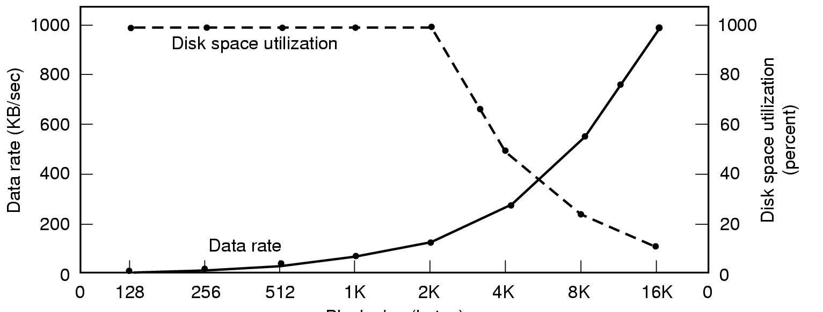
Disk block size
Dark line (left hand scale) gives data rate of a disk
Dotted line (right hand scale) gives disk space efficiency
All files 2KB
Block size

Slide 6

Project 4 Hint

Slide 7
Max Partition Size
Block size | FAT-12 | FAT-16 | FAT-32
0.5 KB | 2 MB
1 KB | 4 MB
2 KB | 8 MB | 128 MB
4 KB | 16 MB | 256 MB | 1 TB
8 KB |  | 512 MB | 2 TB
16 KB |  | 1024 MB | 2 TB
32 KB |  | 2048 MB | 2 TB

Slide 8
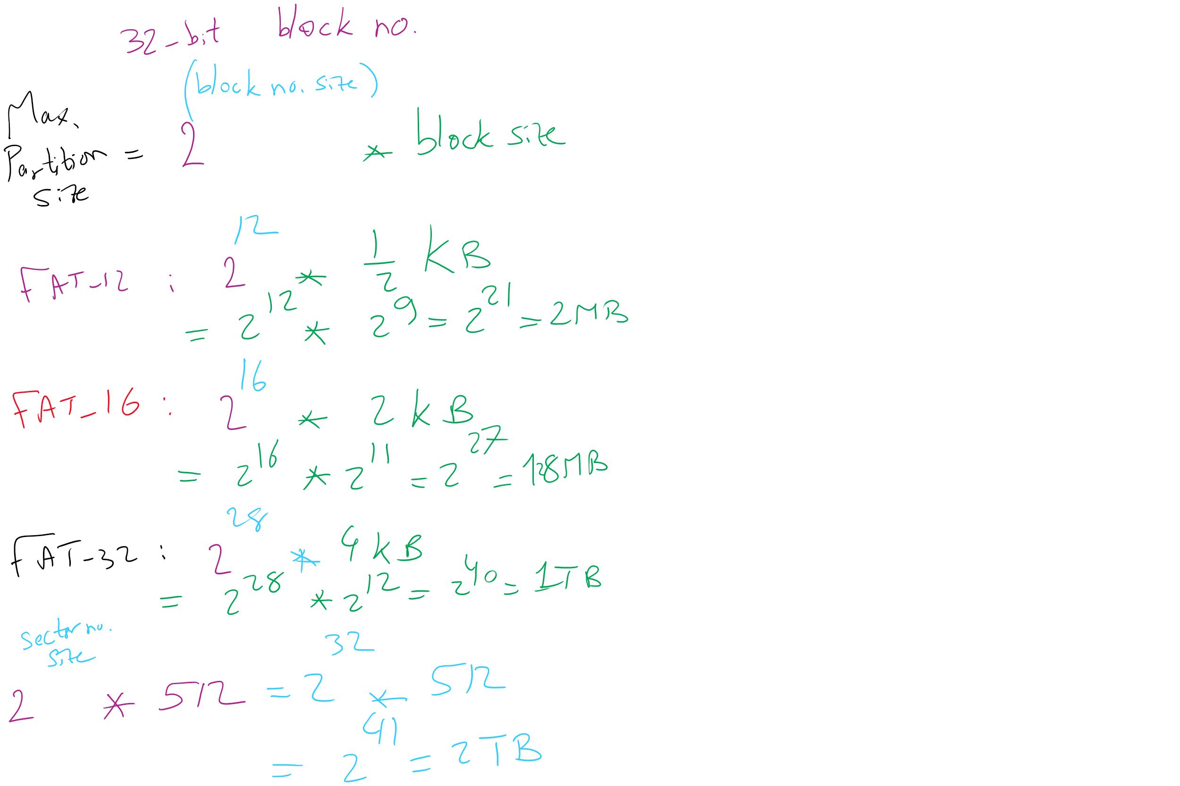
Max Partition Size

Slide 9
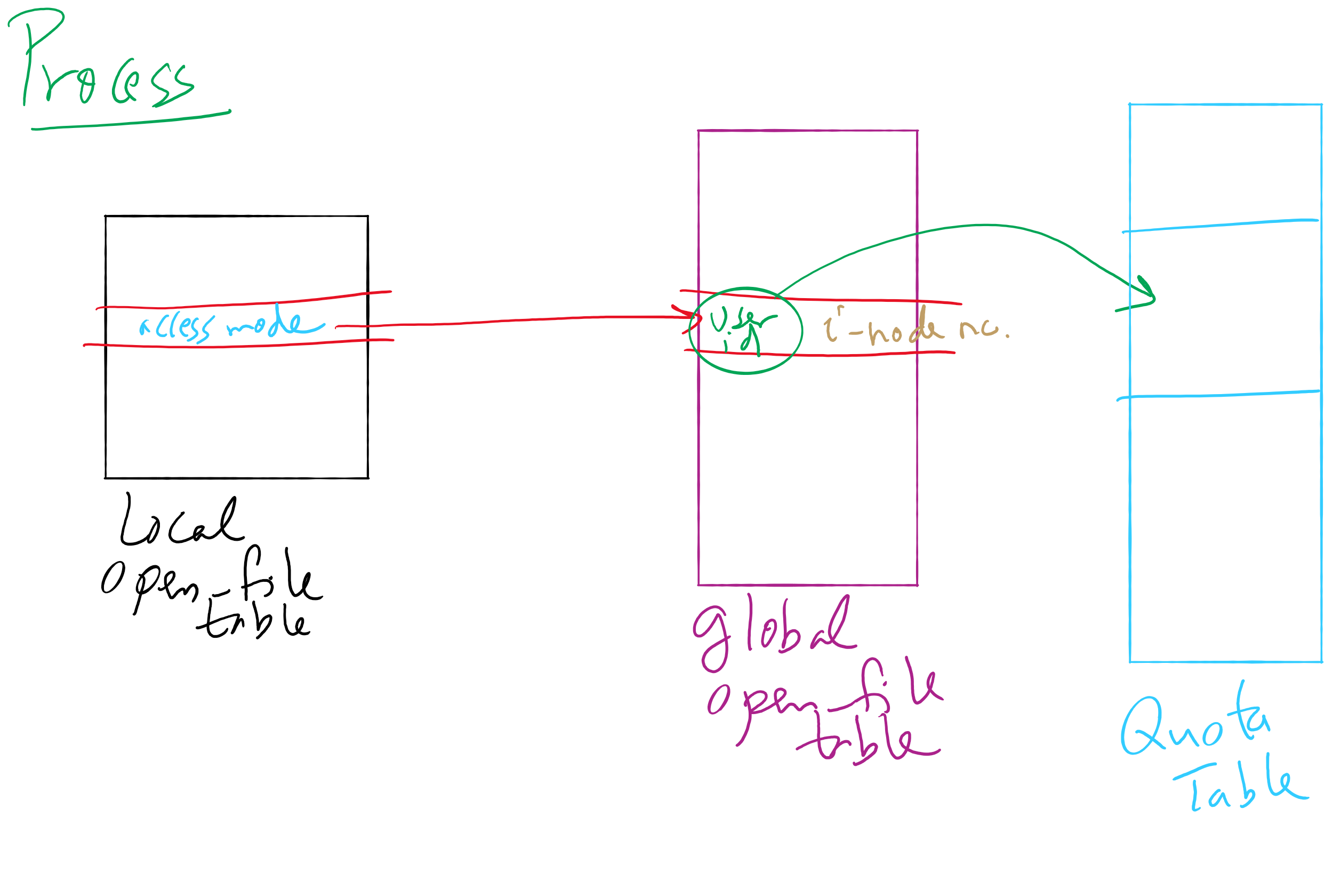
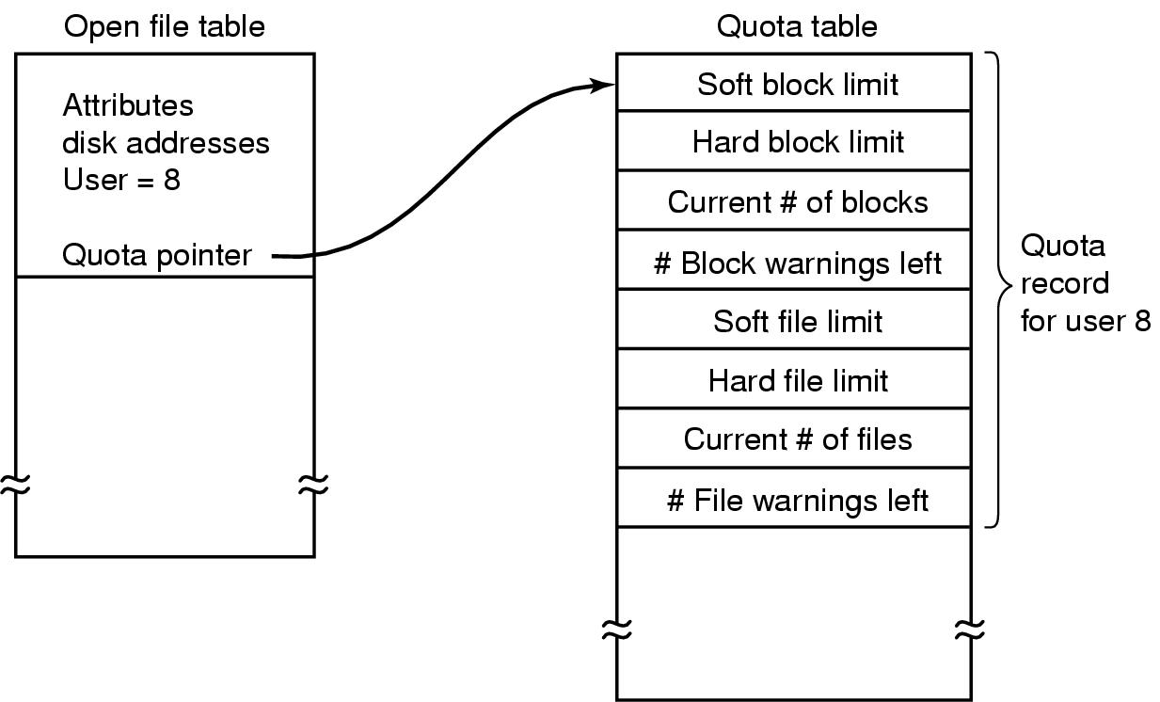
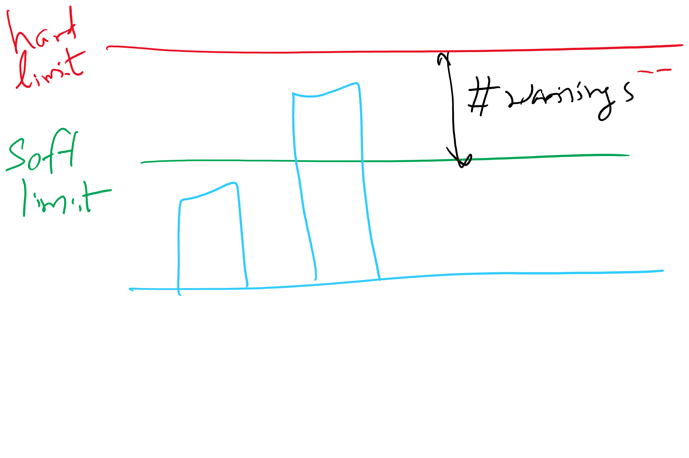
File-related kernel structures: open file tables and disk quotas

Slide 10
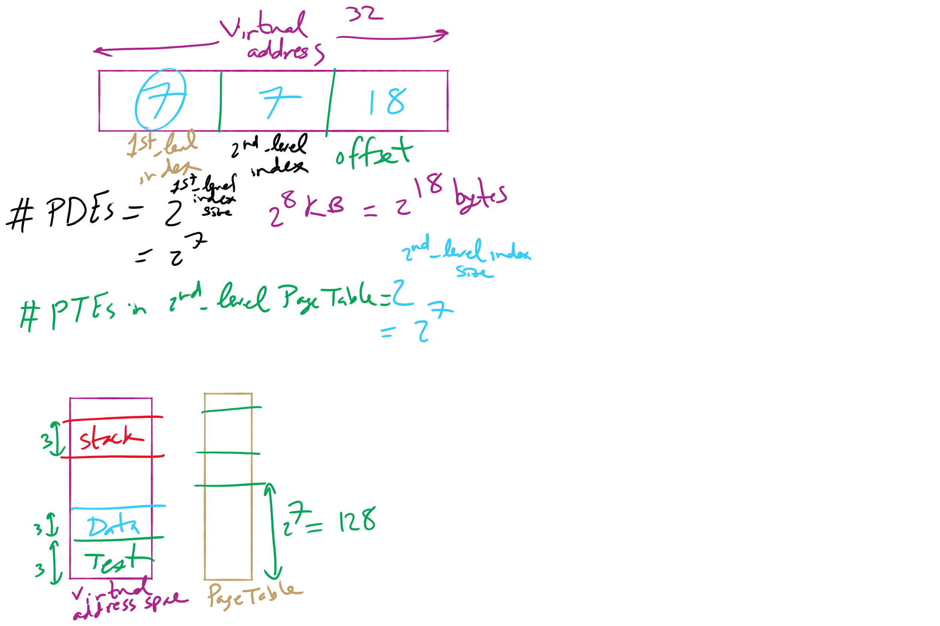
HW 10: Q 2-4

Slide 11
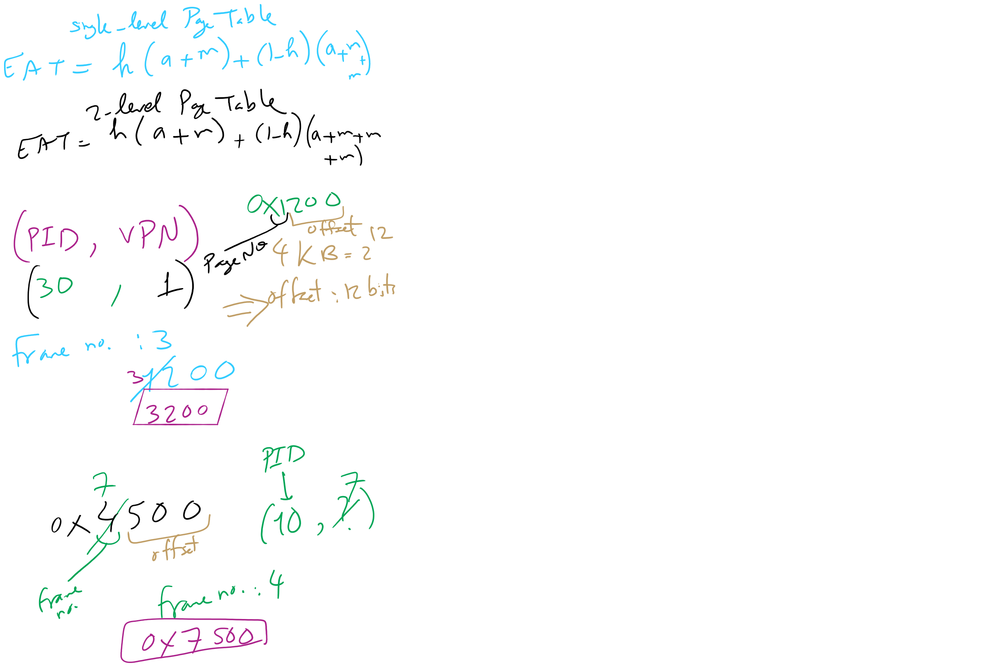
HW 10: Q 10-13

Slide 12
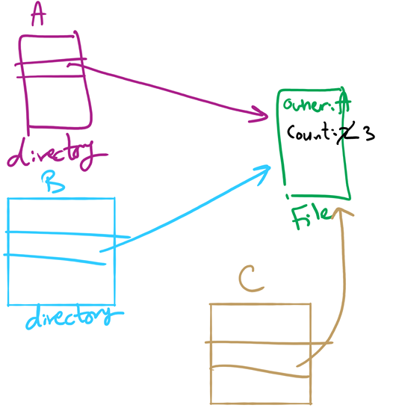
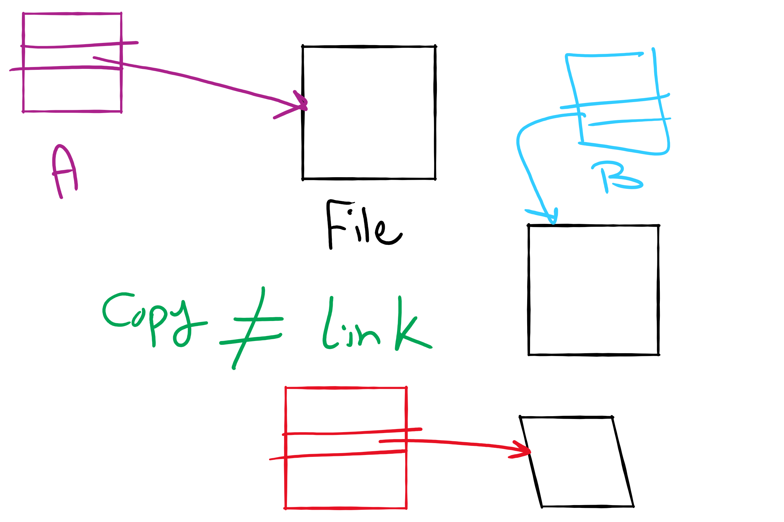
File Linking (left) vs. File Copying (right)

Slide 13
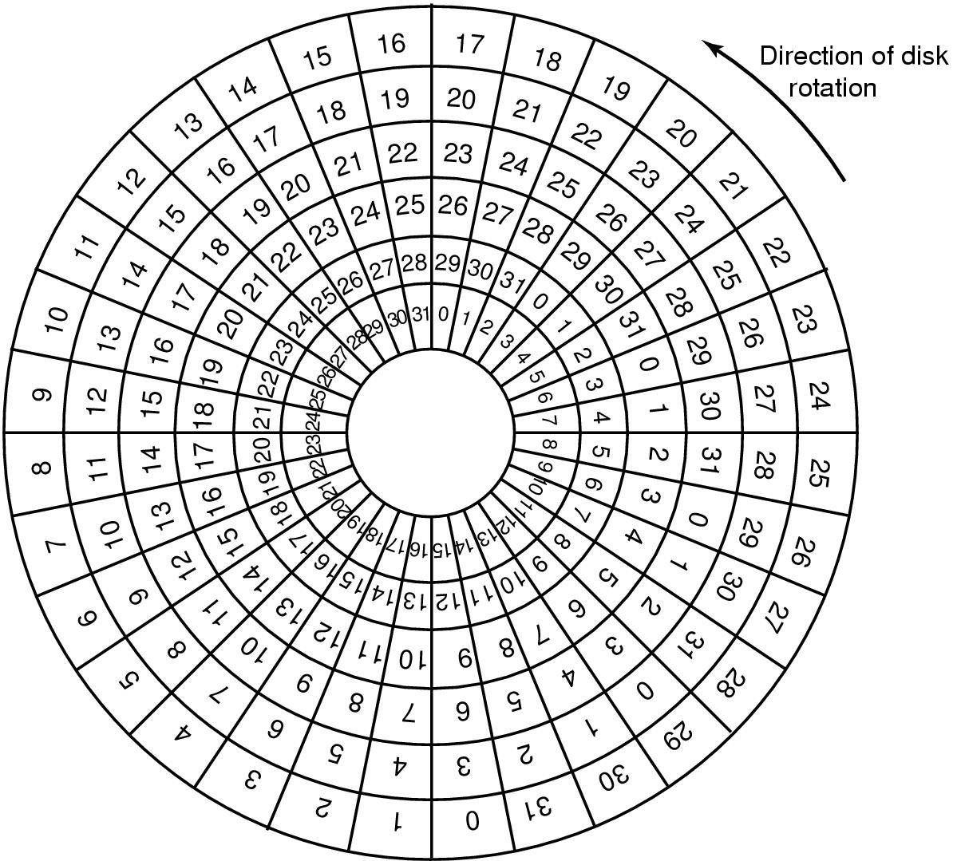
Sector Skew
Sectors numbered sequentially on each track
Numbering starts in different place on each track: sector skew
Allows time for switching head from track to track
All done to minimize delay in sequential transfers

Slide 14
Sector interleaving
On older systems, the CPU was slow => time elapsed between reading consecutive sectors
Solution: leave space between consecutively numbered sectors
This isn’t done much these days…
7
0
7
0
5
0
6
1
3
4
2
3
5
2
6
1
7
6
4
3
2
5
4
1
No interleaving
Skipping 1 sector
Skipping 2 sectors

Slide 15
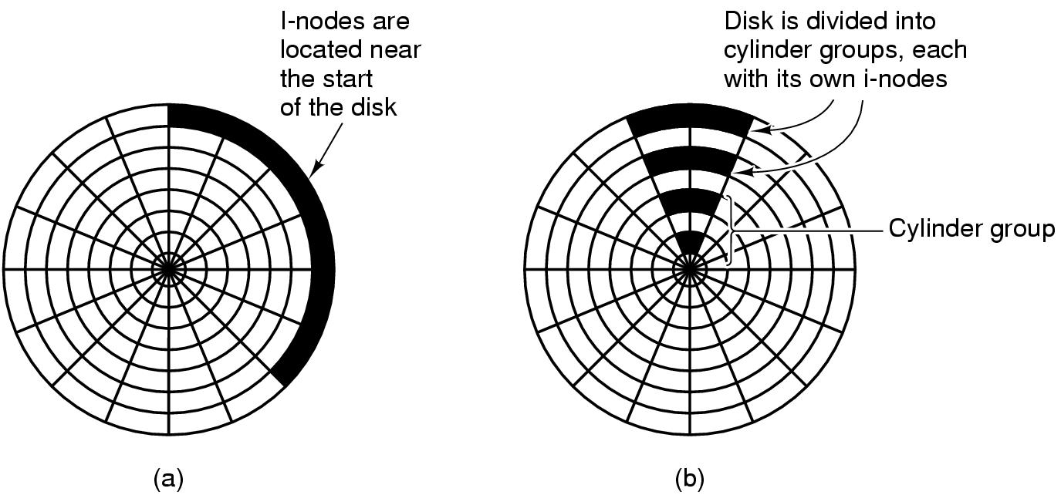
Grouping data on disk

Slide 16
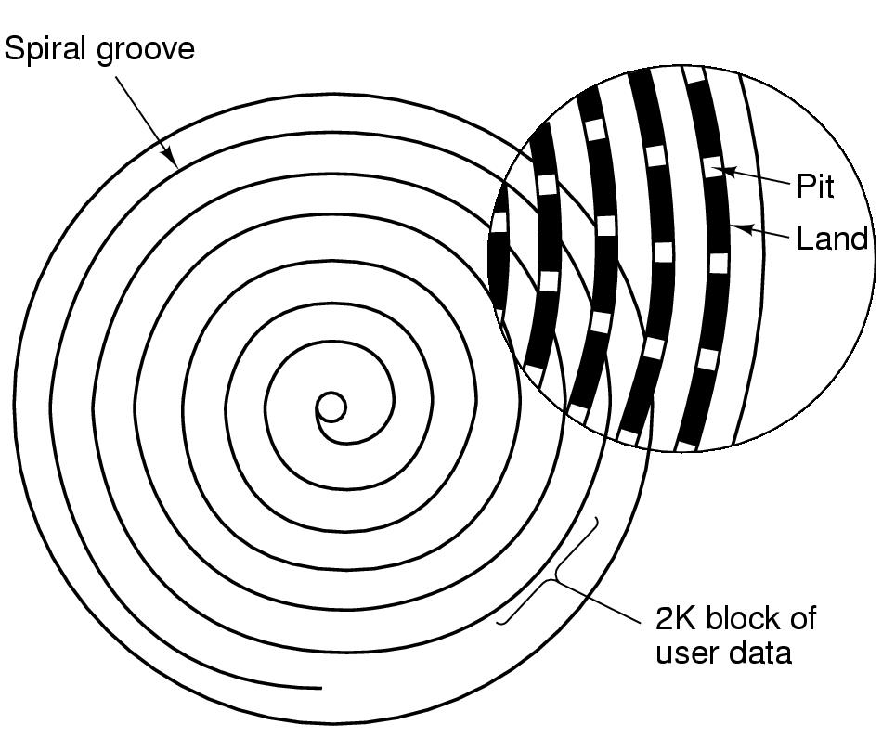
CD-ROM recording
CD-ROM has data in a spiral
Hard drives have concentric circles of data
One continuous track: just like vinyl records!
Pits & lands “simulated” with heat-sensitive material on CD-Rs and CD-RWs

Slide 17
Flash File System
Wear Leveling
Count total writes per flash sector and attempt to balance across the whole disk

Slide 18
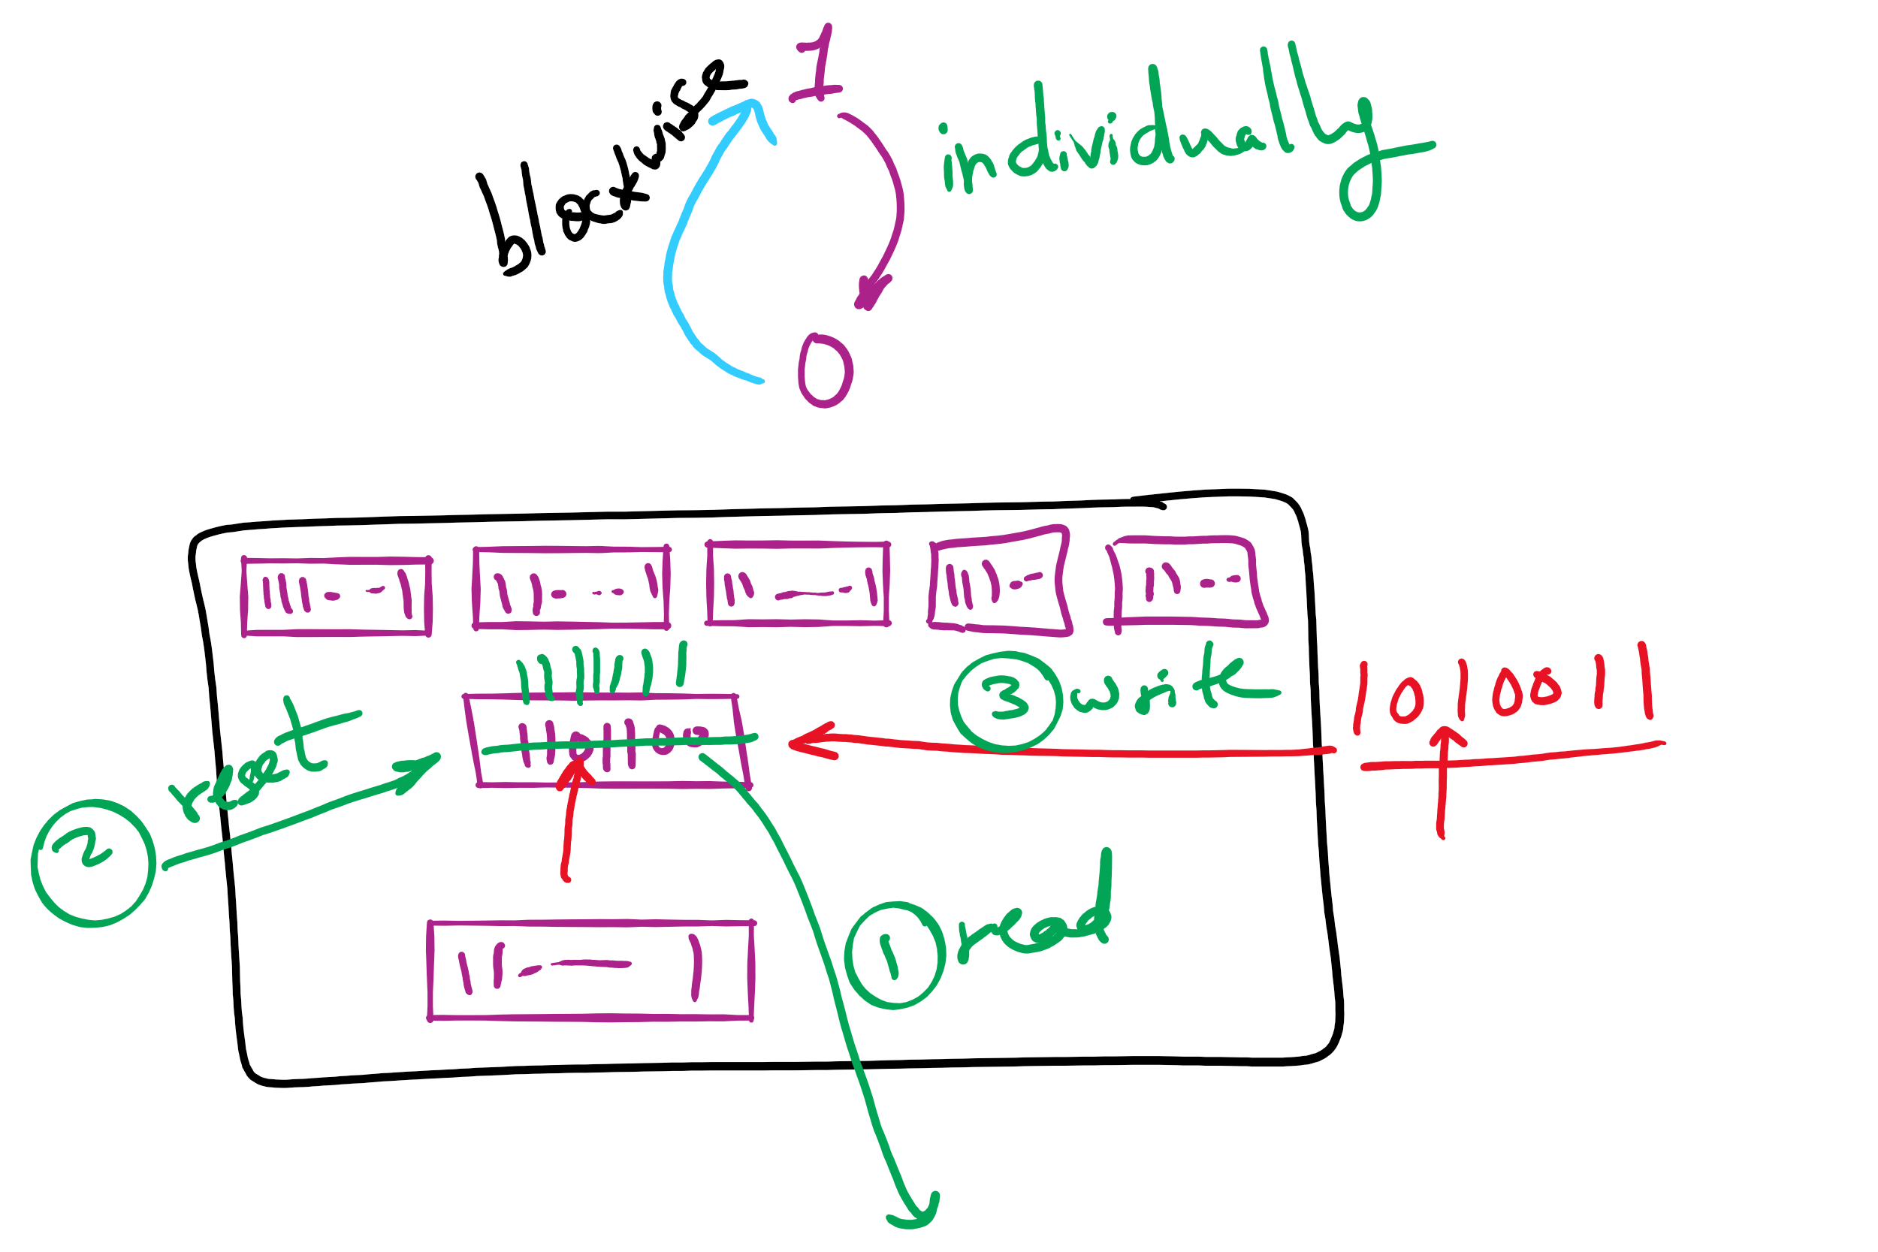
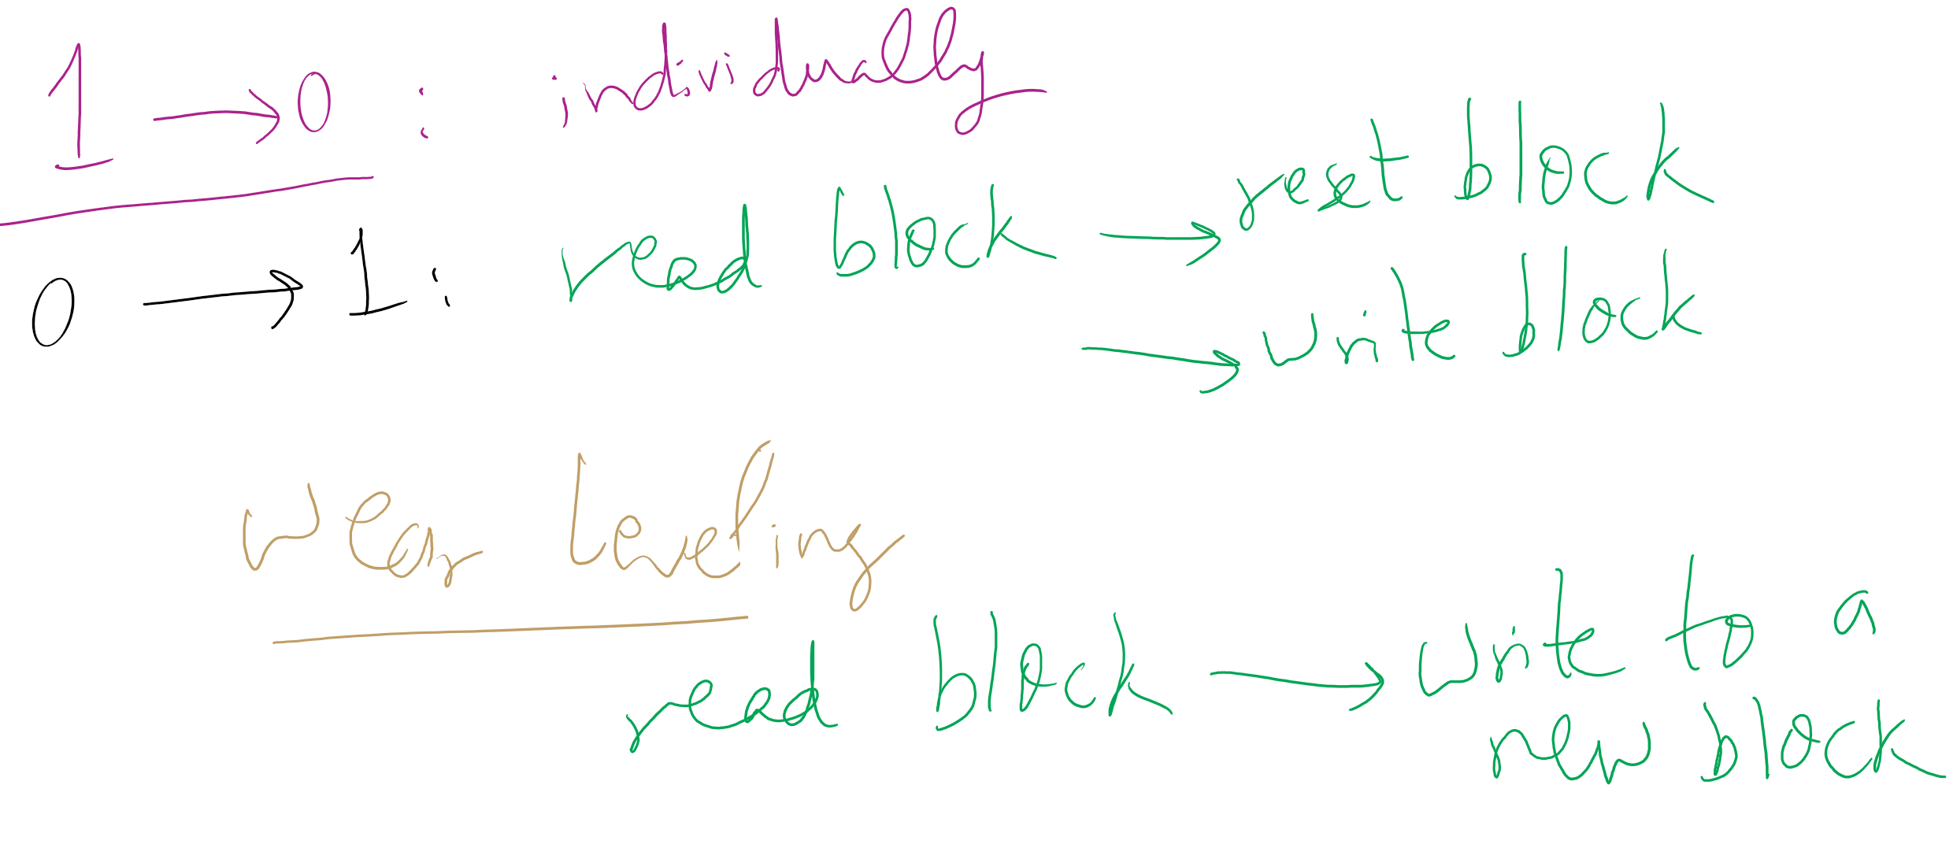
Wear leveling for SSDs

Slide 19
Memory-Mapped vs. separate I/O Space
Memory
0xFFF…
I/O ports
0
Separate I/O & memory space
Memory-mapped I/O
Hybrid: both memory-mapped & separate spaces

Slide 20
Example: Dynamic Frequency on XScale

Slide 21
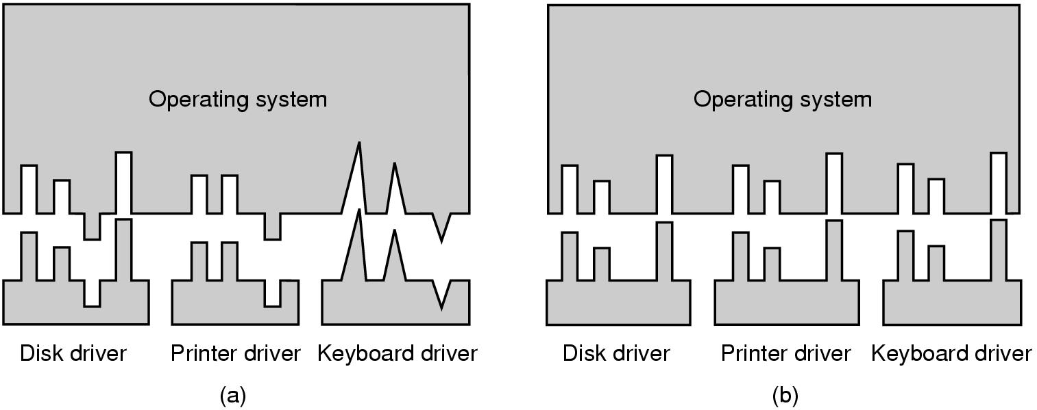
Why a standard driver interface?
Non-standard driver interfaces
Standard driver interfaces

Slide 22
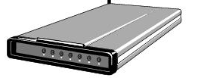
Buffering device input
User space
User space
User space
User space
Kernel space
Kernel space
Kernel space
Kernel space
2
2
1
1
3
Unbuffered input
Buffering in user space
Buffer in kernel Copy to user space
Double buffer in kernel

Slide 23
Disk drive structure
Data stored on surfaces
Up to two surfaces per platter
One or more platters per disk
Data in concentric tracks
Tracks broken into sectors
256B-1KB per sector
Cylinder: corresponding tracks on all surfaces
Data read and written by heads
Actuator moves heads
Heads move in unison
head
sector
platter
track
cylinder
surfaces
spindle
actuator

Slide 24
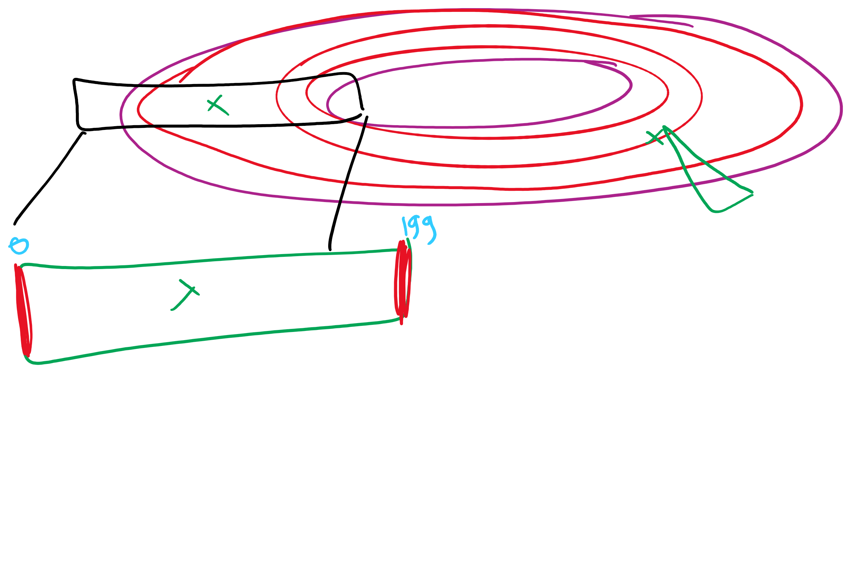
Disk scheduling algorithms
Schedule disk requests to minimize disk seek time
Seek time increases as distance increases (though not linearly)
Minimize seek distance -> minimize seek time
Disk seek algorithm examples assume a request queue & head position (disk has 200 cylinders)
Queue = 100, 175, 51, 133, 8, 140, 73, 77
Head position = 63
Outside edge
Inside edge
8
51
73
100
133
175
77
140
read/write head position
disk requests
(cylinder in which block resides)

Slide 25
First-Come-First Served (FCFS)
Requests serviced in the order in which they arrived
Easy to implement!
May involve lots of unnecessary seek distance
Seek order = 100, 175, 51, 133, 8, 140, 73, 77
Seek distance = (100-63) + (175-100) + (175-51) + (133-51) + (133-8) + (140-8) + (140-73) + (77-73) = 646 cylinders
read/write head start
100
175
51
133
8
140
73
77

Slide 26
Shortest Seek Time First (SSTF)
Service the request with the shortest seek time from the current head position
Form of SJF scheduling
May starve some requests
Seek order = 73, 77, 100, 133, 140, 175, 51, 8
Seek distance = 10 + 4 + 23 + 33 + 7 + 35 + 124 + 43 = 279 cylinders
read/write head start
73
77
51
8
133
100
140
175

Slide 27
SCAN (elevator algorithm)
Disk arm starts at one end of the disk and moves towards the other end, servicing requests as it goes
Reverses direction when it gets to end of the disk
Also known as elevator algorithm
Seek order = 51, 8, 0 , 73, 77, 100, 133, 140, 175
Seek distance = 12 + 43 + 8 + 73 + 4 + 23 + 33 + 7 + 35 = 238 cyls
read/write head start
51
8
73
77
100
133
140
175

Slide 28
C-SCAN
Identical to SCAN, except head returns to cylinder 0 when it reaches the end of the disk
Treats cylinder list as a circular list that wraps around the disk
Waiting time is more uniform for cylinders near the edge of the disk
Seek order = 73, 77, 100, 133, 140, 175, 199, 0, 8, 51
Distance = 10 + 4 + 23 + 33 + 7 + 35 + 24 + 199 + 8 + 43 = 386 cyls
read/write head start
73
77
100
133
140
175
8
51

Slide 29
C-LOOK
Identical to C-SCAN, except head only travels as far as the last request in each direction
Saves seek time from last sector to end of disk
Seek order = 73, 77, 100, 133, 140, 175, 8, 51
Distance = 10 + 4 + 23 + 33 + 7 + 35 + 167 + 43 = 322 cylinders
read/write head start
73
77
100
133
140
175
8
51

